Slide 1

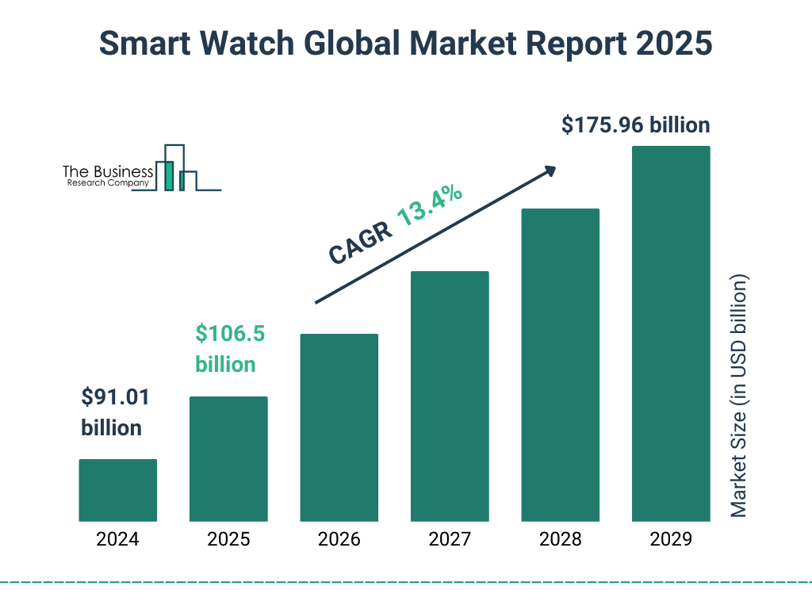
Understanding Smartwatch User Behavior: A Data-Driven Perspective
Presented by:
Palash Mahata

Slide 2
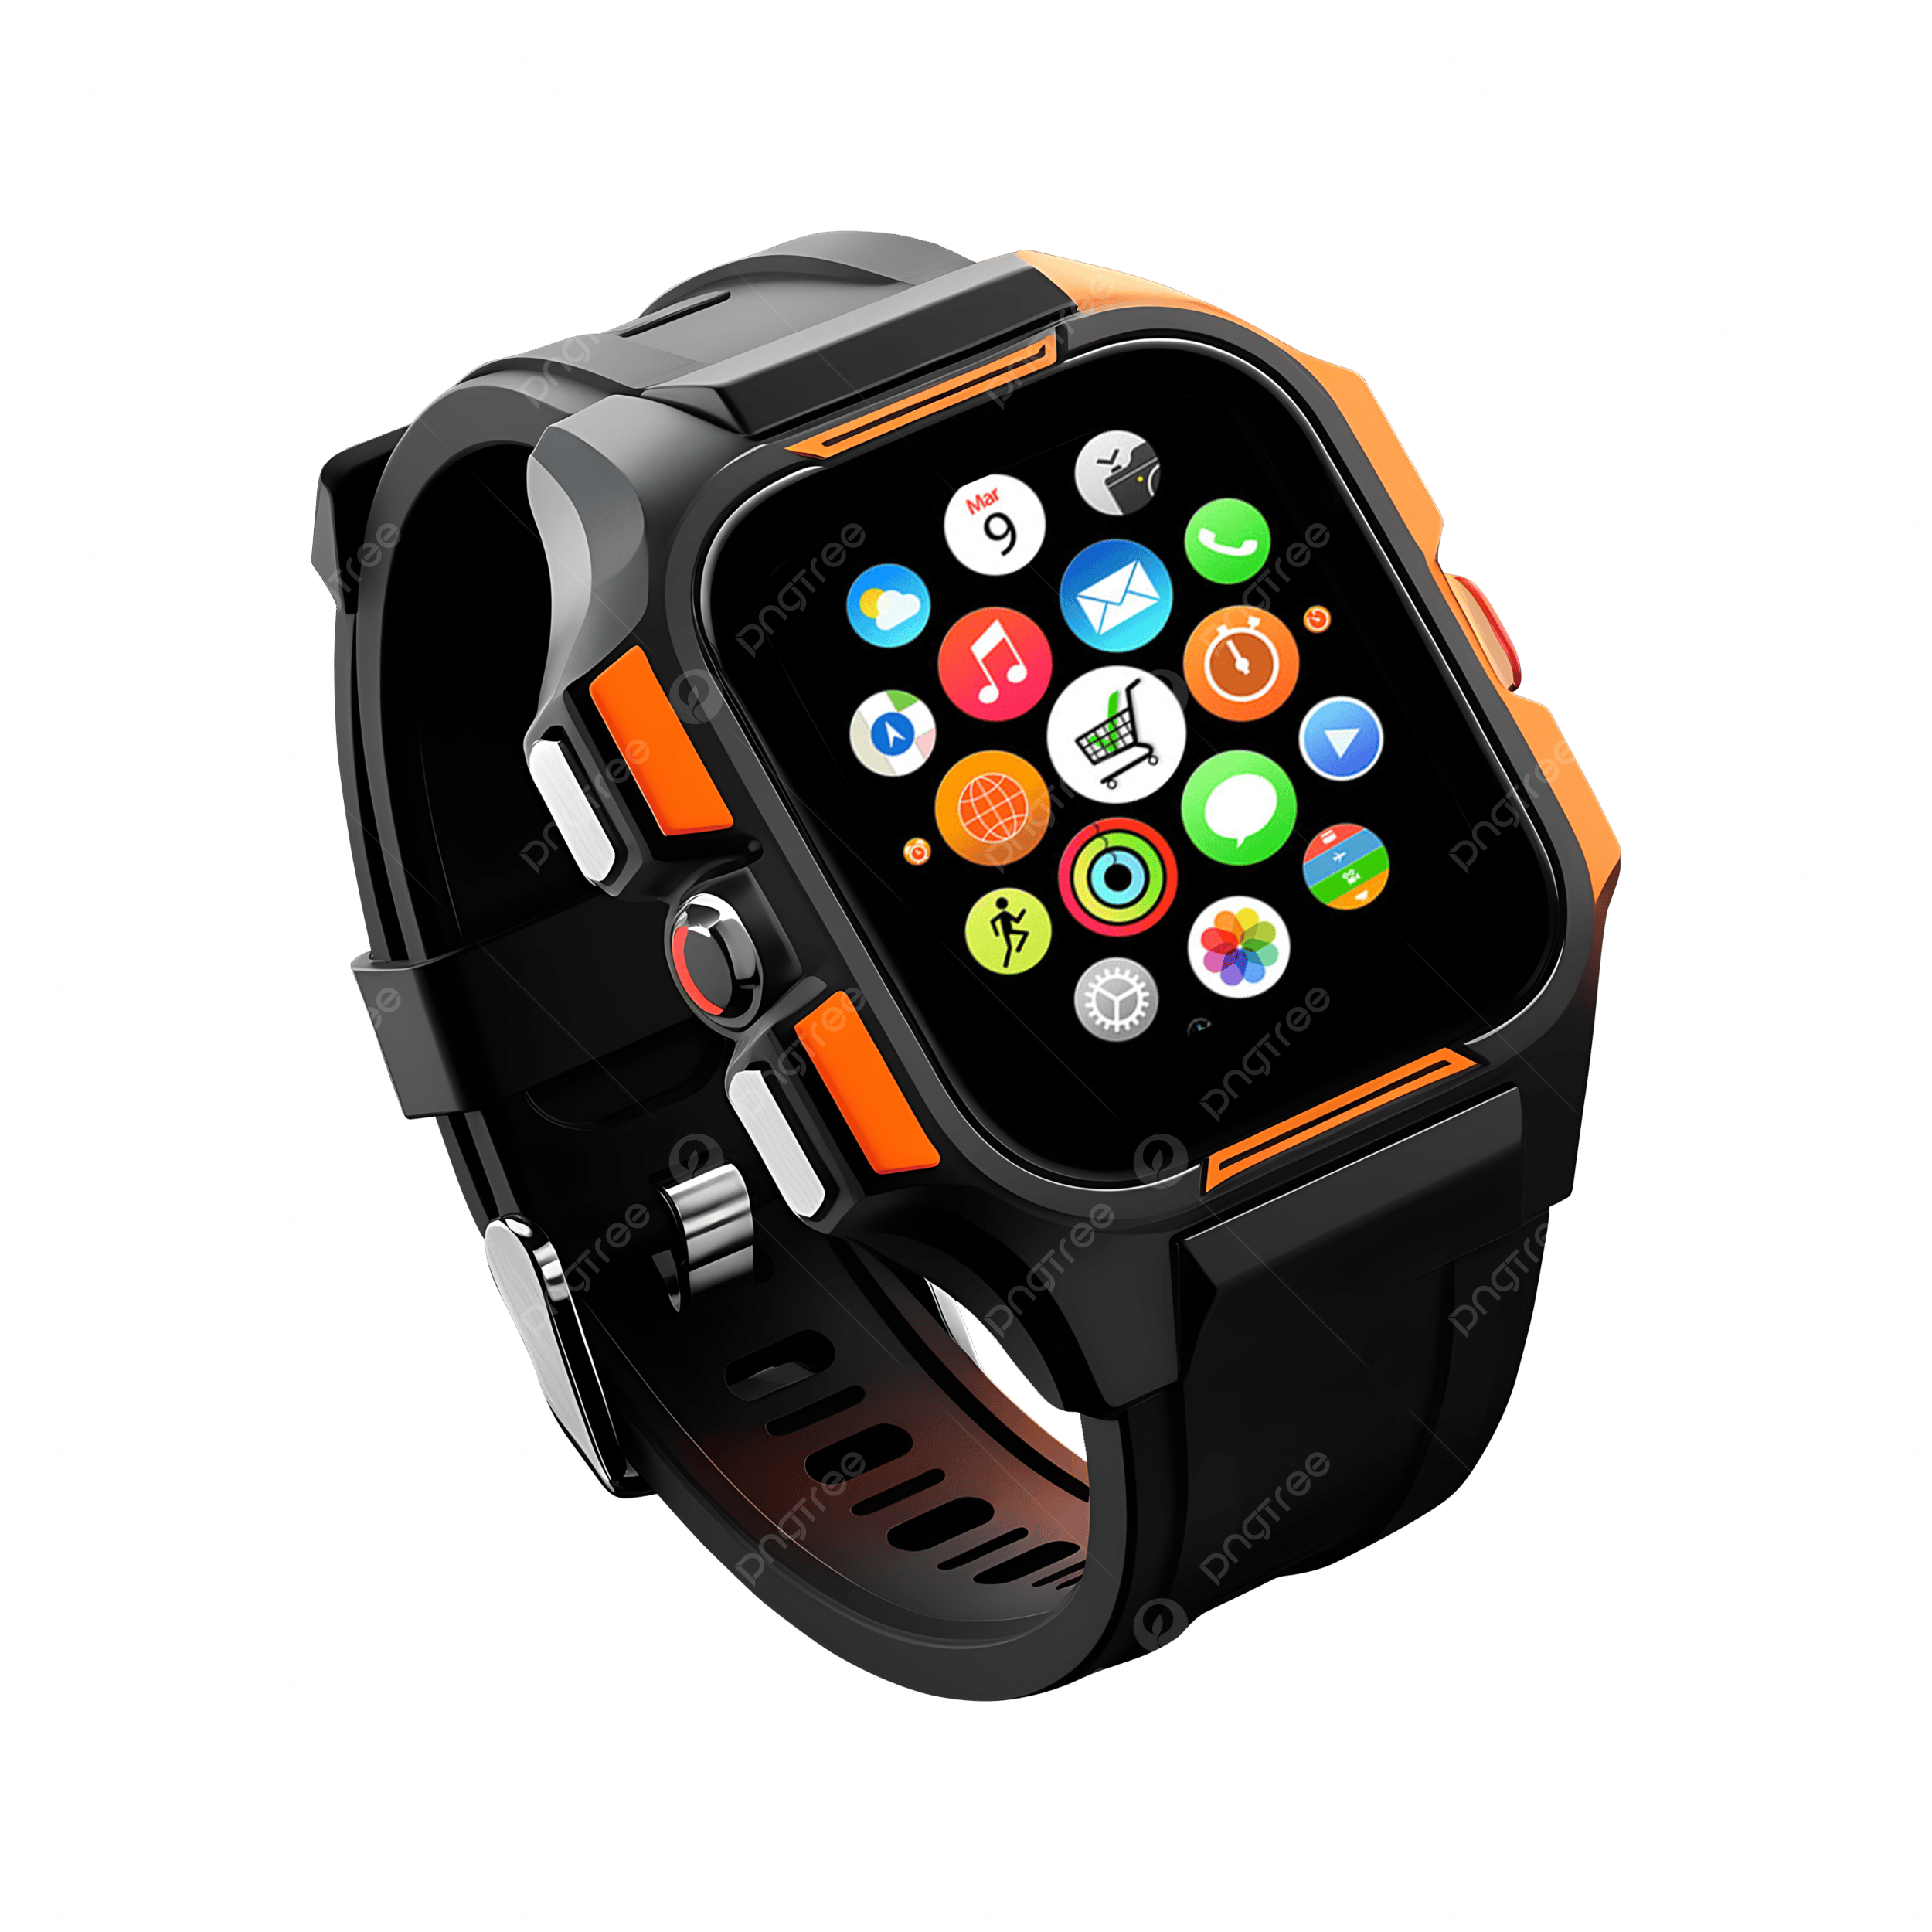
Introduction
Objective: The primary objective of this study is to analyze the factors influencing the buying behavior and satisfaction of smartwatch users, and to understand what drives retention and recommendation among customers.
Key focus points:
Identify demographic patterns
Explore user preferences and satisfaction
Test statistical hypotheses
Run Regression tests
Provide actionable insights

Slide 3
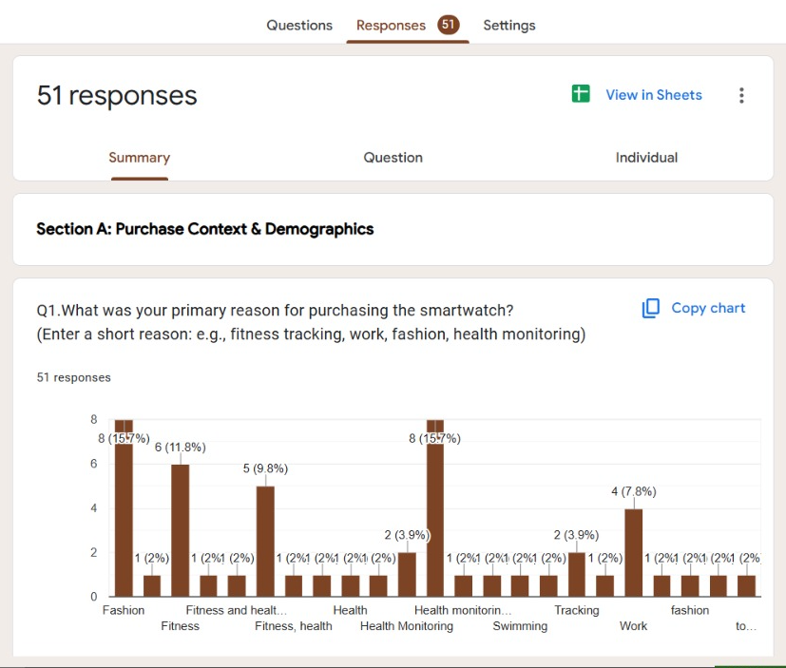
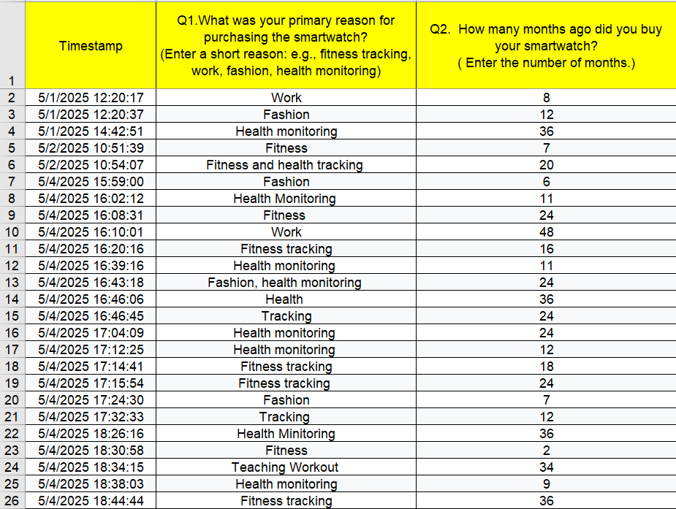
Data Collection
Primary survey has been done to get the data using Google survey forms. The sample size chosen is 51 with a diverse demographics.

Slide 4
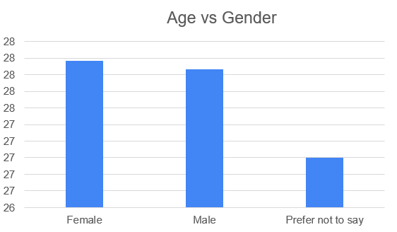
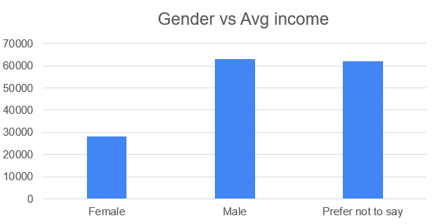
Demographics
The data taken is demographically diverse among all age groups and gender.

Slide 5
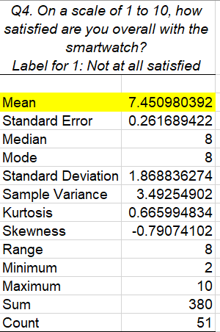
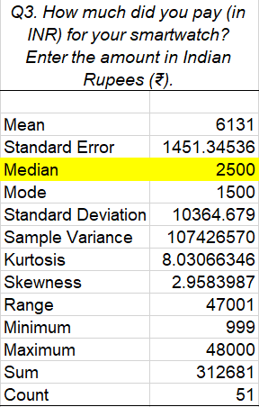
Feature usage & Satisfaction
As per the Exploratory Data Analysis, it is found out:
Mean satisfaction level is 7.45
Median of price paid to buy the smartwatch is ₹2500.
Age group is between 18-55 with a mean of 28.

Slide 6
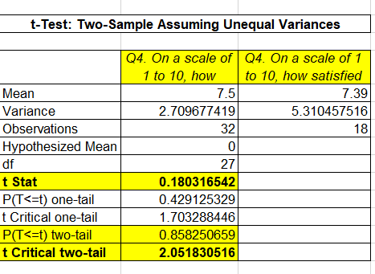
Hypothesis Testing
To test whether there is any significant difference in satisfaction level of male and female.
T-test has been performed which inferred that the null hypothesis cannot be rejected as t stat is 0.18 compared to the critical value 2.05 with a p-value of 0.85. That concludes that there is no significant difference in satisfaction level between male and female.

Slide 7
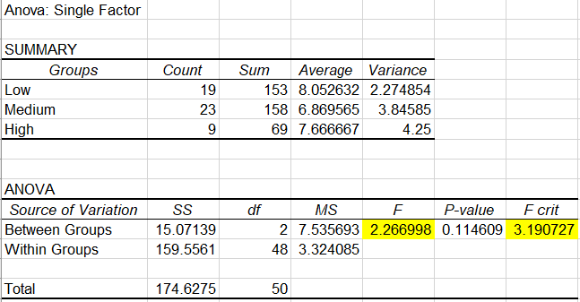
ANOVA
ANOVA objective: Does spending category(price of the watch) affect satisfaction?
It is inferred from the test that there the price spend on buying the watch does not affect the satisfaction level of the consumers (F value: 2.26, f-crit : 3.19).

Slide 8
Linear Regression Analysis
Dependent variable taken is: Satisfaction level of the customers
Predictors: Recommendation score, lifestyle change, usage frequency
R Square: 0.41, means the model explains 41% of the variance in the dependent variable indicating a moderate fit and Significance F: 0.000014 statistically significant model, indicating at least one predictor variable is significant.

Slide 9
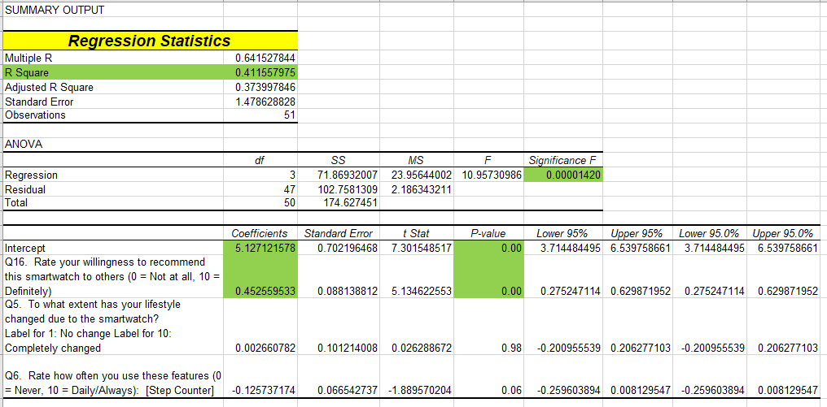
Linear Regression test results

Slide 10
Logistic Regression
Key Findings:
- Willingness to recommend is the most powerful predictor of satisfaction—indicating that net promoter score (NPS) is tightly aligned with real user experience.
- Battery life and daily wear time moderately increase satisfaction, reinforcing the value of functional reliability and long-term usage comfort.
- Price paid and frequency of interaction did not significantly impact satisfaction—suggesting that users value utility over cost or engagement frequency.

Slide 11
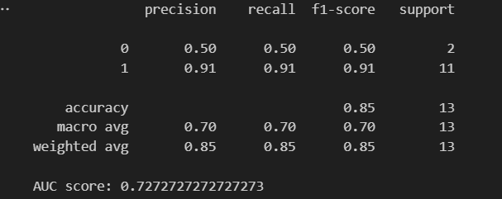
Logistic Regression results
The Accuracy is 85% it means 85 out 100 users satisfaction prediction were correct.
AUC(Area under ROC curve): AUC of 0.73 means there are 73% chance of our model will rank a randomly chosen satisfied user higher than a not satisfied one.
High accuracy and high AUC indicates model is not overfitting which is seen in this case.

Slide 12
Conclusion
Survey of 50+ smartwatch users analyzed for buying patterns and satisfaction.
Demographics show diverse usage across age, gender, and income groups.
Top satisfaction drivers: health tracking accuracy, battery life, and design appeal.
T-test & ANOVA reveal significant differences in satisfaction across gender and spending categories.
Linear Regression model explains ~41% of satisfaction variance, driven by usage frequency, lifestyle impact, and recommendation score.
Logistic Regression model with an accuracy of 85% driven by willingness to recommend as the most powerful predictor.
Key Insight: Users who feel lifestyle improvement and frequently use the watch are more satisfied and likely to recommend.
Recommendation: focus on improving daily-use features and emphasizing lifestyle benefits in marketing.

Slide 13
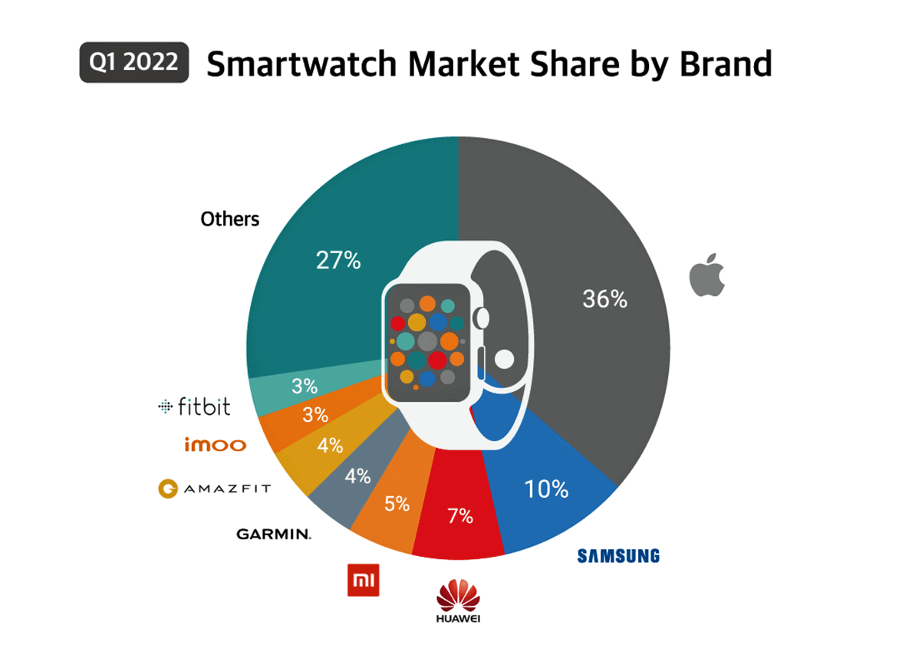
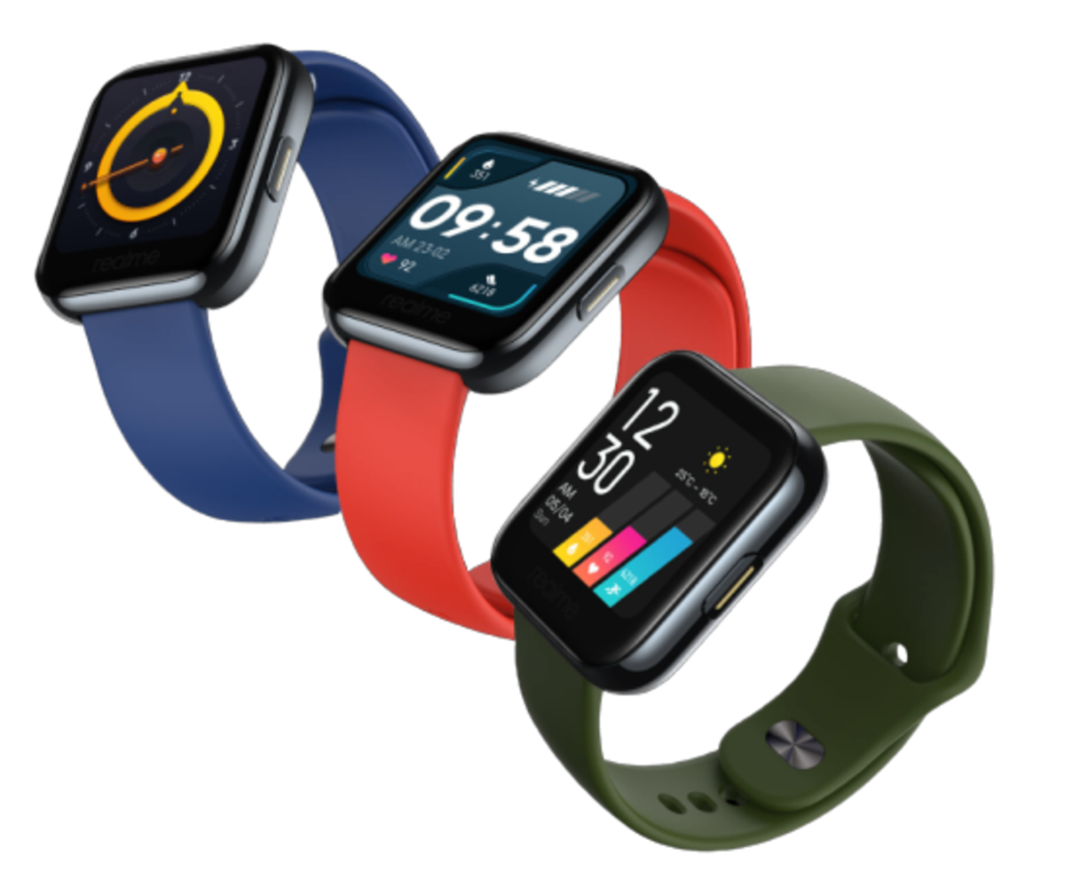
Thank You!

